Slide 1
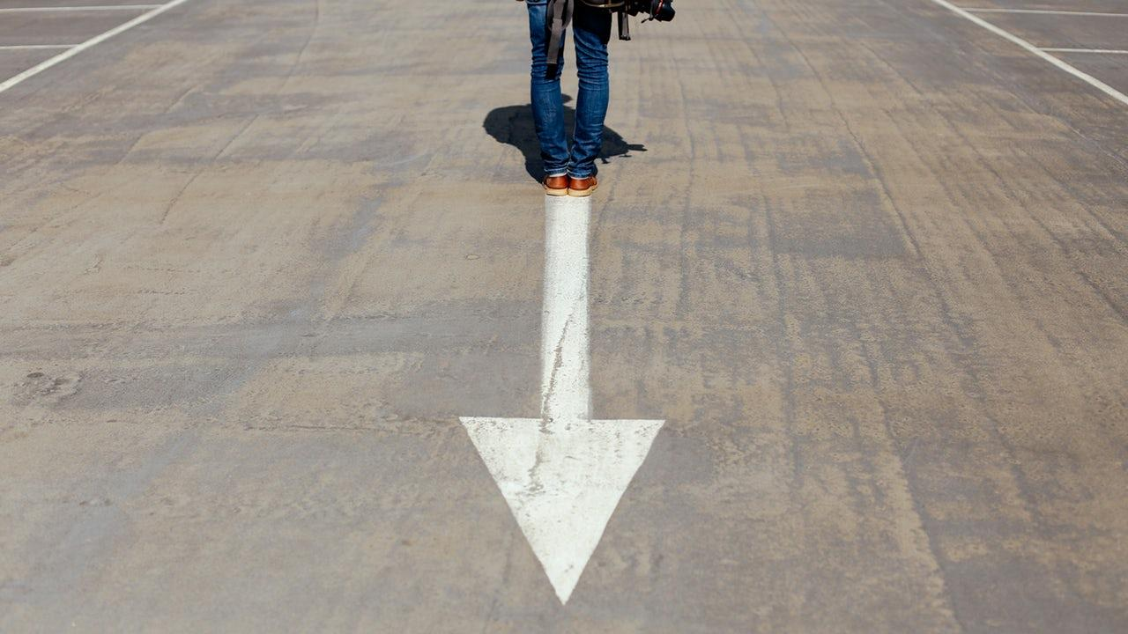

ByVarsling-
Smartere kommunikasjon
mellom innbyggere og by I Kristiansand Kommune

Slide 2


Slide 4
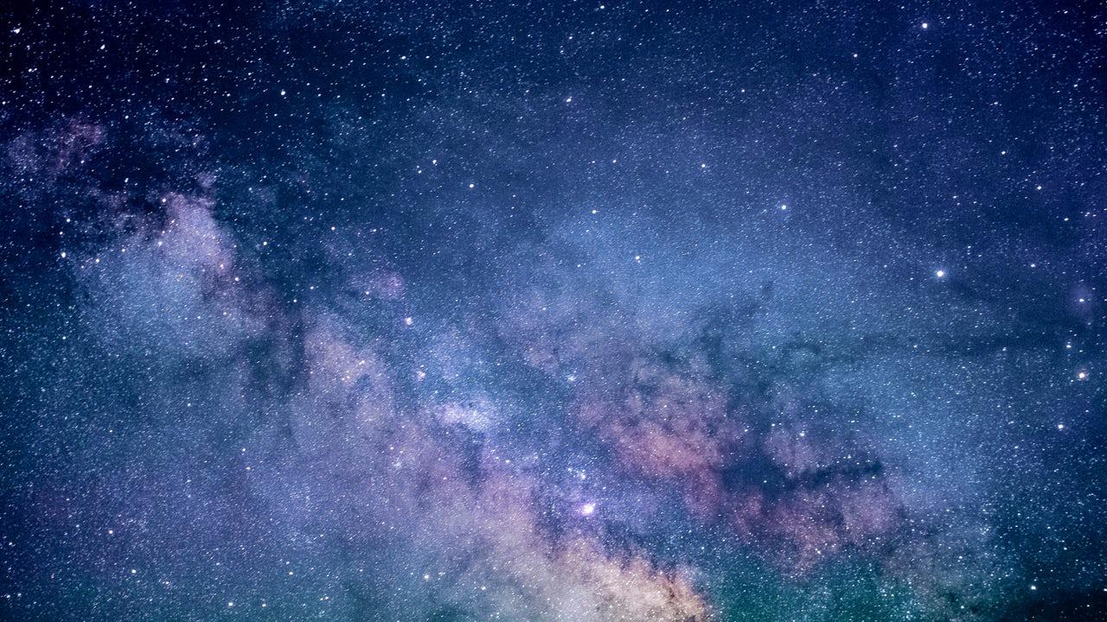
3 Delt Plattform
Sentral
Web applikasjon
Bildedeling

Slide 5
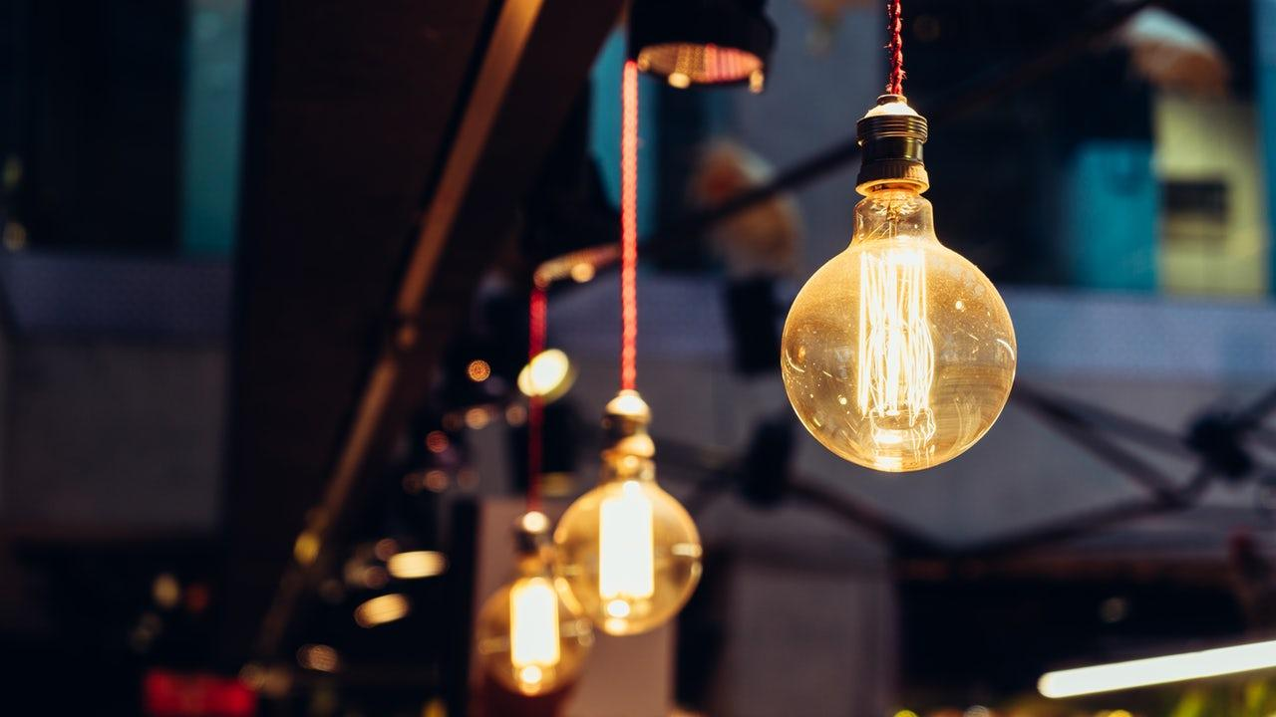
Utallige bruksmuligheter
Hva kan meldes inn?
Hull i veien
Slukket lyktestolpe
Ideer om teknologiske forbedringer
Lange køer
Melde fra om krasj

Slide 6
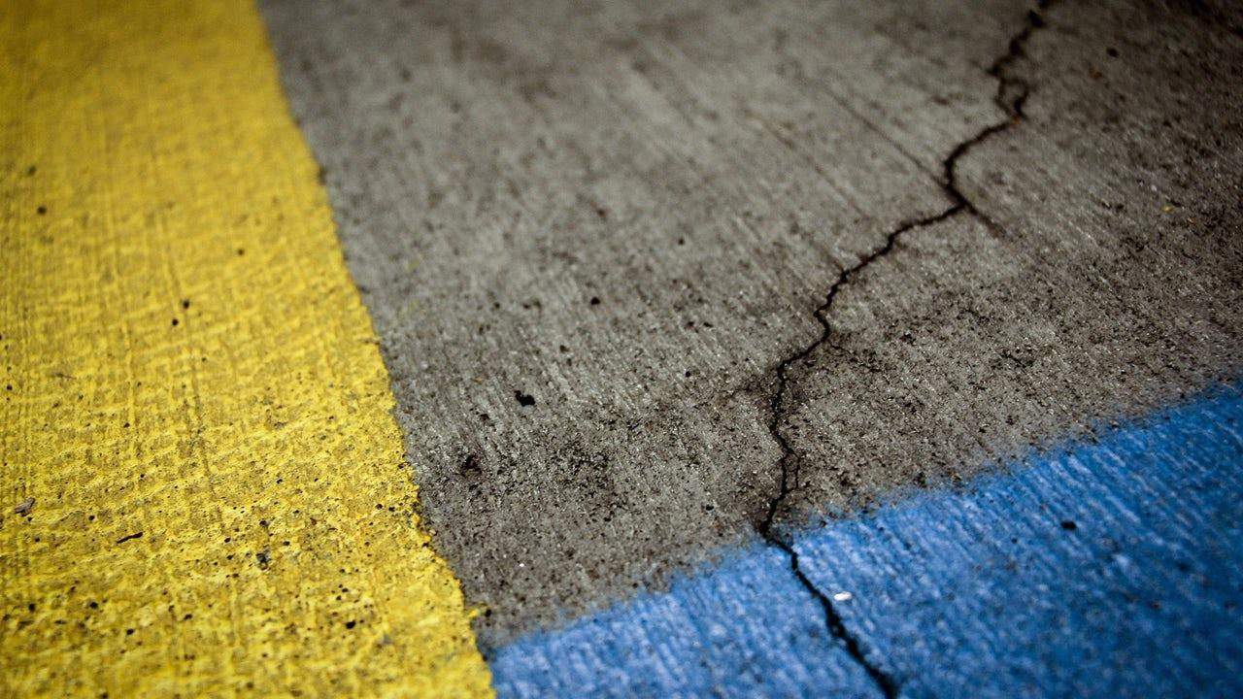
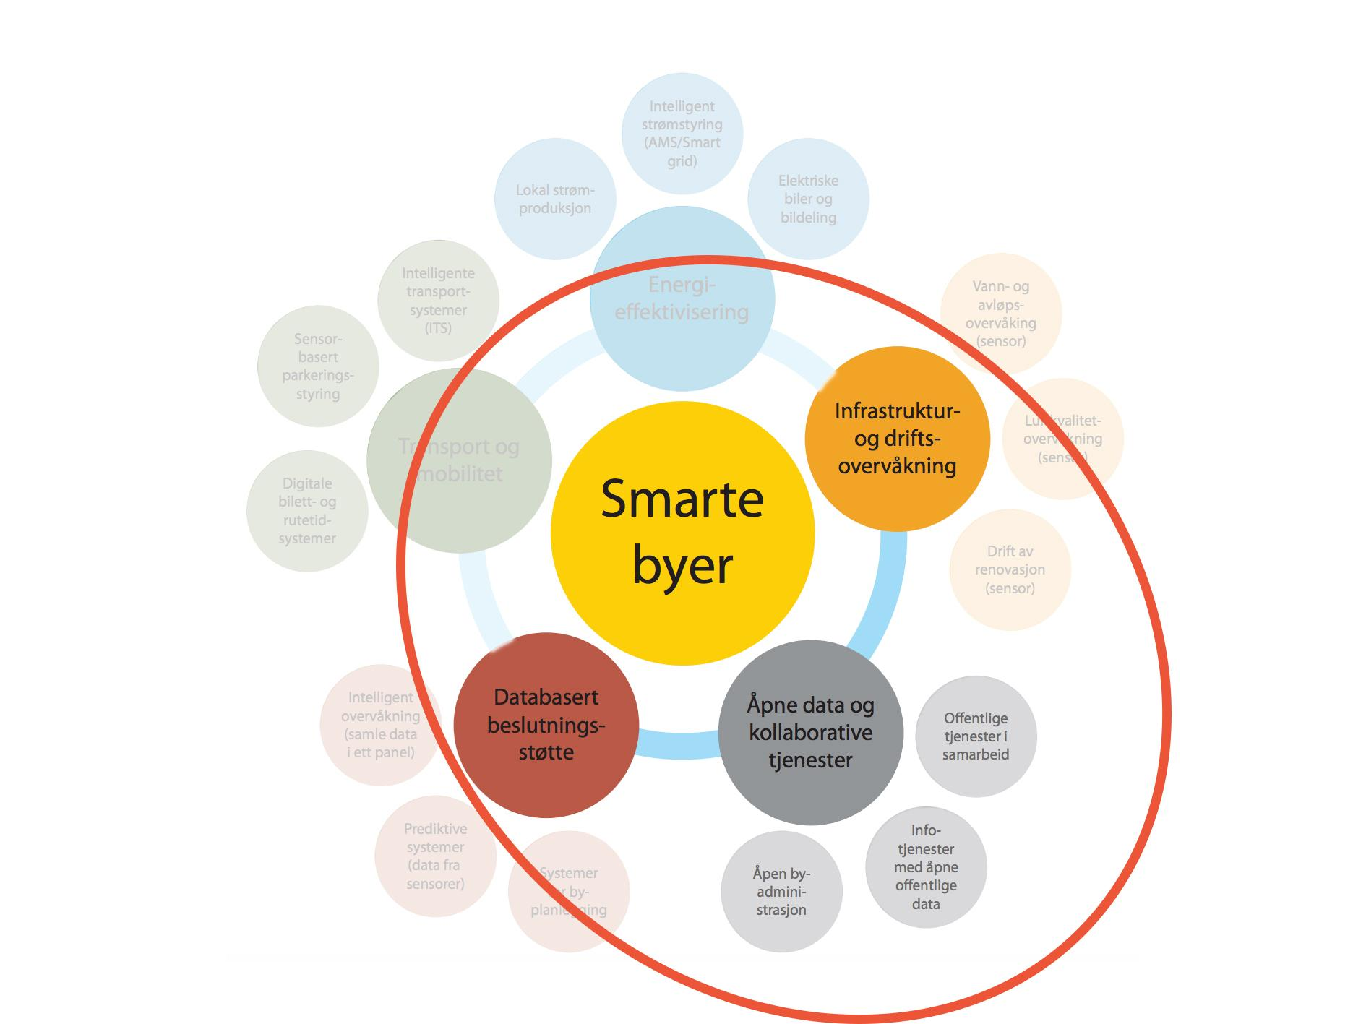
Folk føler seg hørt
Innsamling og offentliggjøring av data
Forbedre byen sammen
Byen får et moderne og demokratisk image

Slide 8
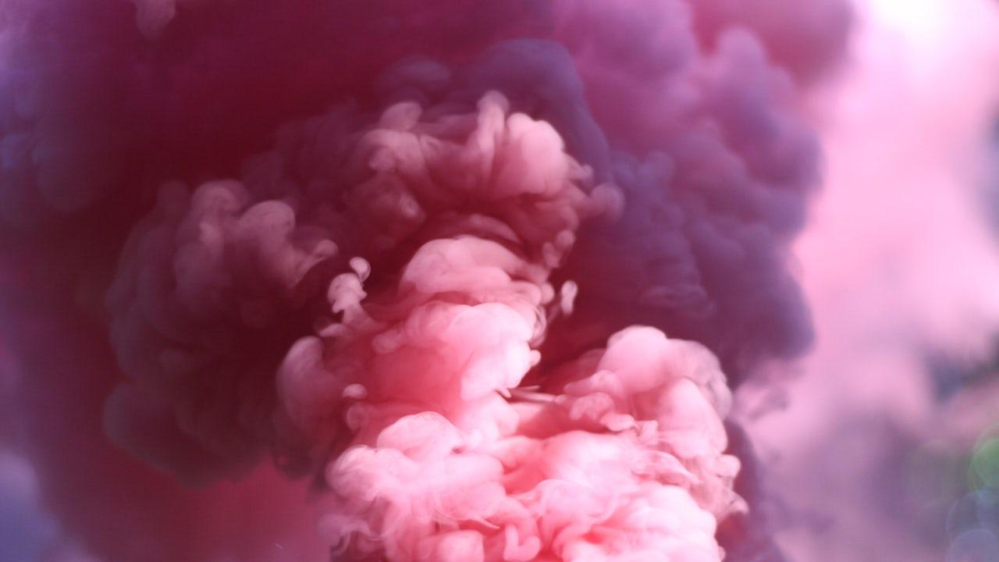
Hvordan fungerer det?
Kommunens sentral
Bildedeling på app
Fra brukeren
Web applikasjon
Der kart og annen data blir pulisert
En del data
Blir tilgjengelig for offentligheten

Slide 9
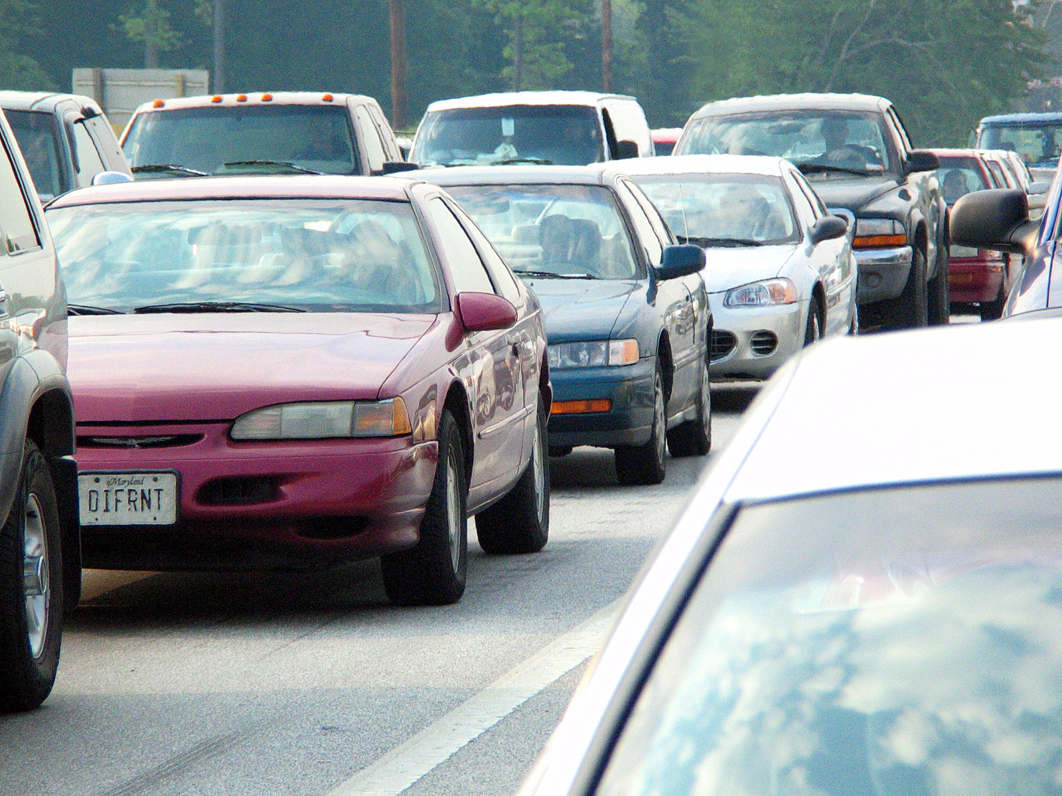
Supplement til nødtelefonen
og som innsamling av kritisk data til ingeniørvesenet og andre etater.

Slide 10
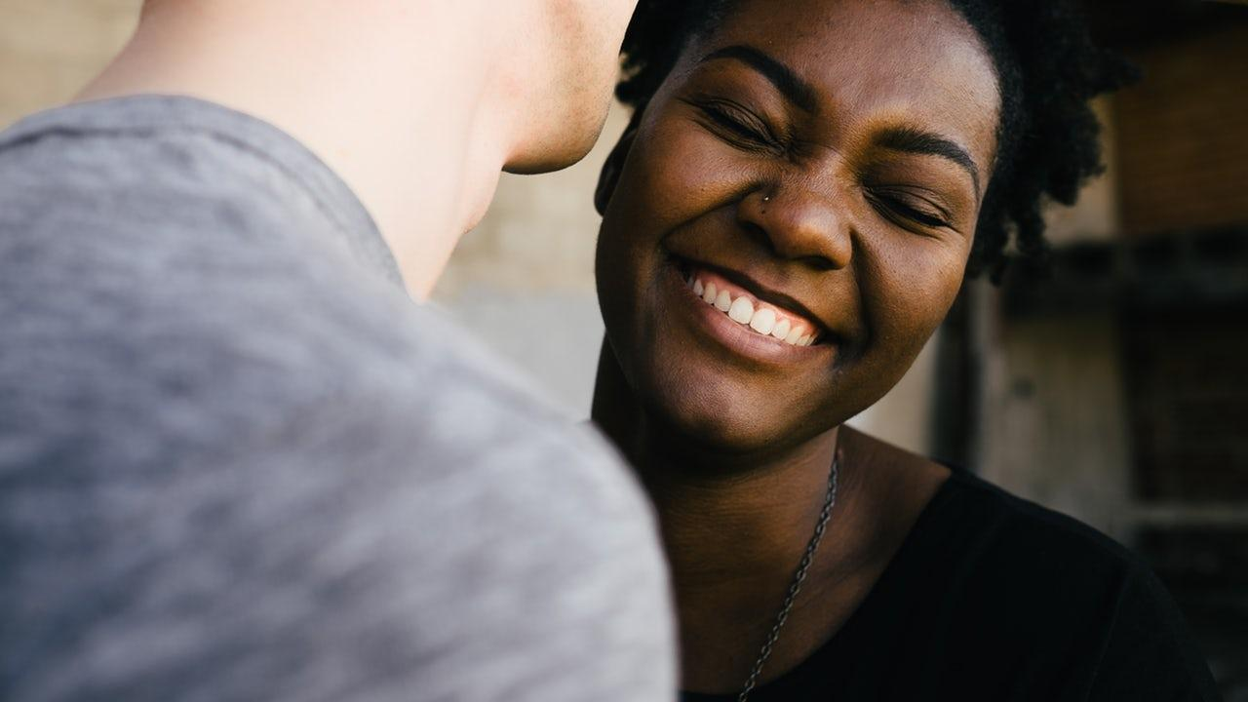
Hello!
I am Jayden Smith
I am here because I love to give presentations.
You can find me at @username

Slide 11
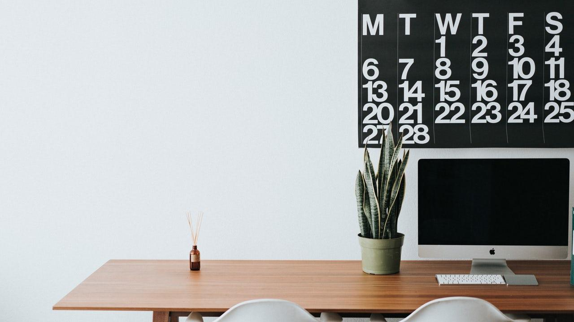
1.
Transition headline
Let’s start with the first set of slides

Slide 12
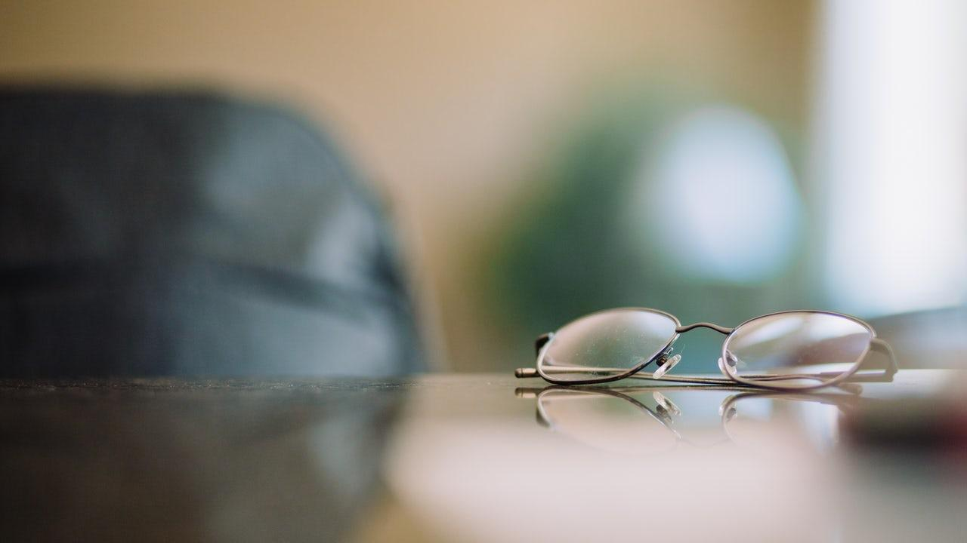
This is a slide title
Here you have a list of items
And some text
But remember not to overload your slides with content
Your audience will listen to you or read the content, but won’t do both.

Slide 13
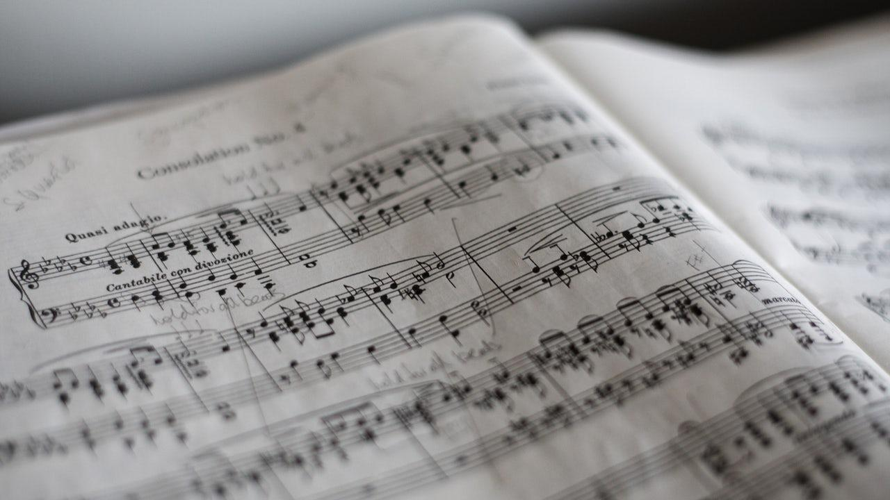
You can also split your content
White
Is the color of milk and fresh snow, the color produced by the combination of all the colors of the visible spectrum.
Black
Is the color of coal, ebony, and of outer space. It is the darkest color, the result of the absence of or complete absorption of light.

Slide 14

In two or three columns
Yellow
Is the color of gold, butter and ripe lemons. In the spectrum of visible light, yellow is found between green and orange.
Blue
Is the colour of the clear sky and the deep sea. It is located between violet and green on the optical spectrum.
Red
Is the color of blood, and because of this it has historically been associated with sacrifice, danger and courage.

Slide 15
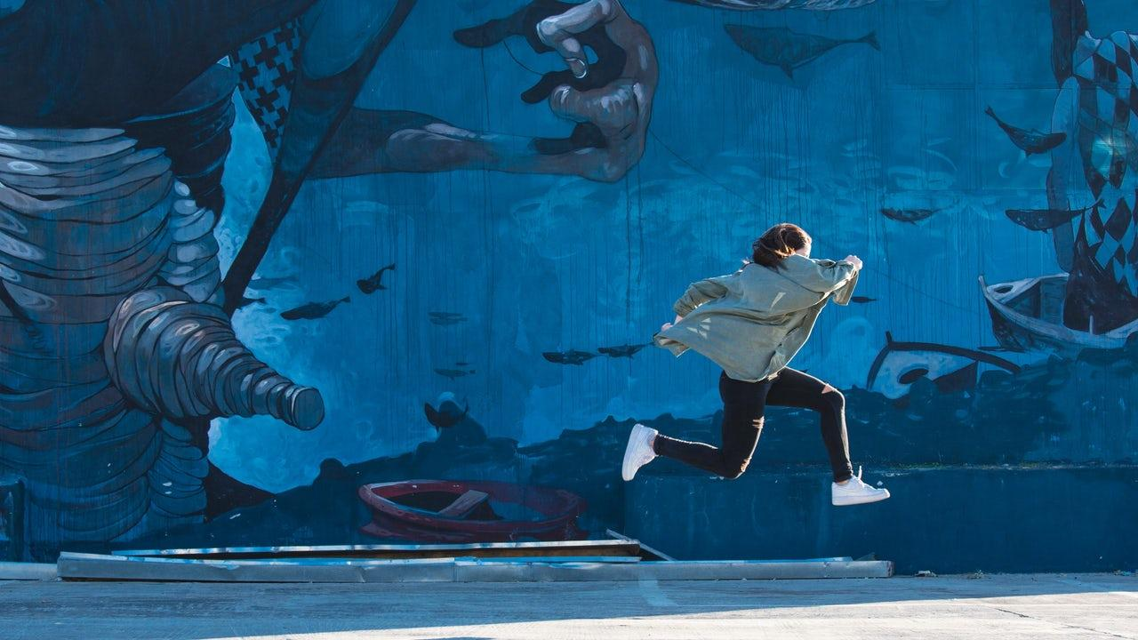
A picture is worth a thousand words
A complex idea can be conveyed with just a single still image, namely making it possible to absorb large amounts of data quickly.

Slide 16

Want big impact?
Use big image.

Slide 17

And tables to compare data
 | A | B | C
Yellow | 10 | 20 | 7
Blue | 30 | 15 | 10
Orange | 5 | 24 | 16

Slide 18

Maps
our office

Slide 19
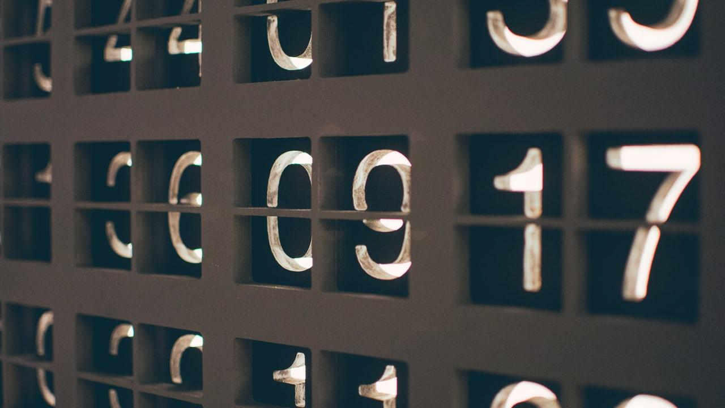
89,526,124
Whoa! That’s a big number, aren’t you proud?

Slide 20
89,526,124$
185,244 users
100%
That’s a lot of money
And a lot of users
Total success!

Slide 21
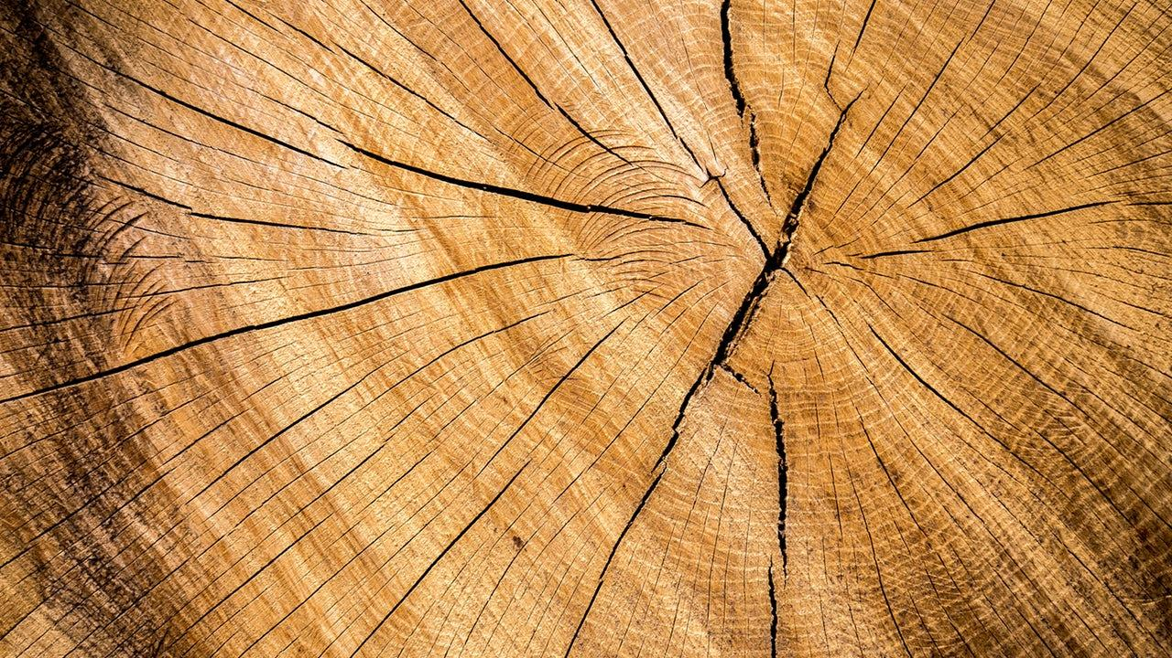
Our process is easy
1.
first
2.
second
3.
last

Slide 22
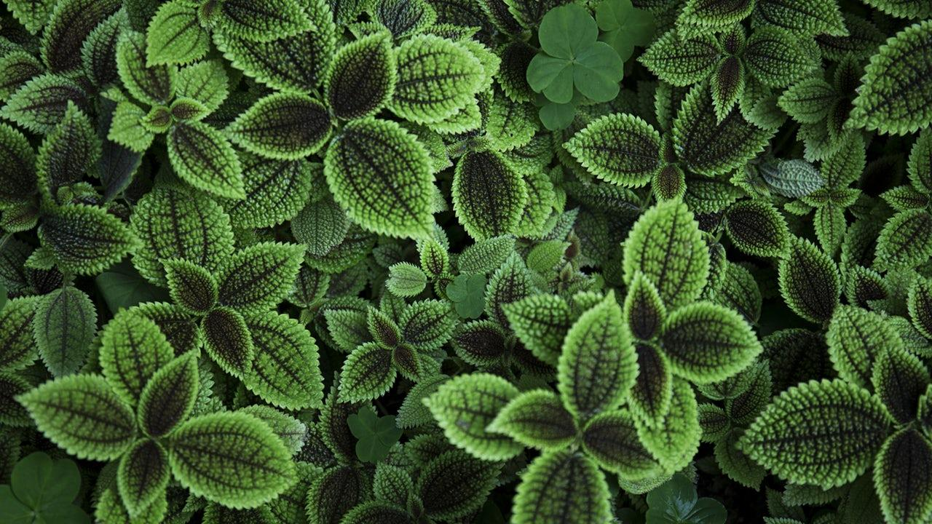
Let’s review some concepts
Yellow
Is the color of gold, butter and ripe lemons. In the spectrum of visible light, yellow is found between green and orange.
Blue
Is the colour of the clear sky and the deep sea. It is located between violet and green on the optical spectrum.
Red
Is the color of blood, and because of this it has historically been associated with sacrifice, danger and courage.
Yellow
Is the color of gold, butter and ripe lemons. In the spectrum of visible light, yellow is found between green and orange.
Blue
Is the colour of the clear sky and the deep sea. It is located between violet and green on the optical spectrum.
Red
Is the color of blood, and because of this it has historically been associated with sacrifice, danger and courage.

Slide 23

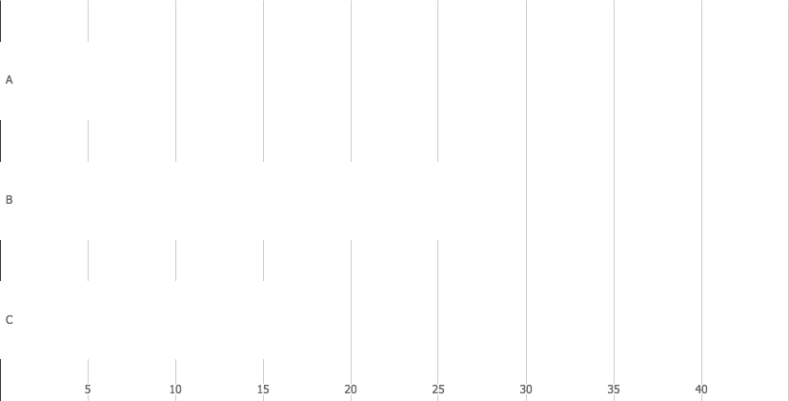
You can insert graphs from Google Sheets

Slide 24
Android project
Show and explain your web, app or software projects using these gadget templates.
Place your screenshot here

Slide 25
Tablet project
Show and explain your web, app or software projects using these gadget templates.
Place your screenshot here

Slide 26
Desktop project
Show and explain your web, app or software projects using these gadget templates.
Place your screenshot here

Slide 27

Thanks!
Any questions?
You can find me at:
@username
user@mail.me

Slide 28

Credits
Special thanks to all the people who made and released these awesome resources for free:
Presentation template by SlidesCarnival
Photographs by Unsplash

Slide 29
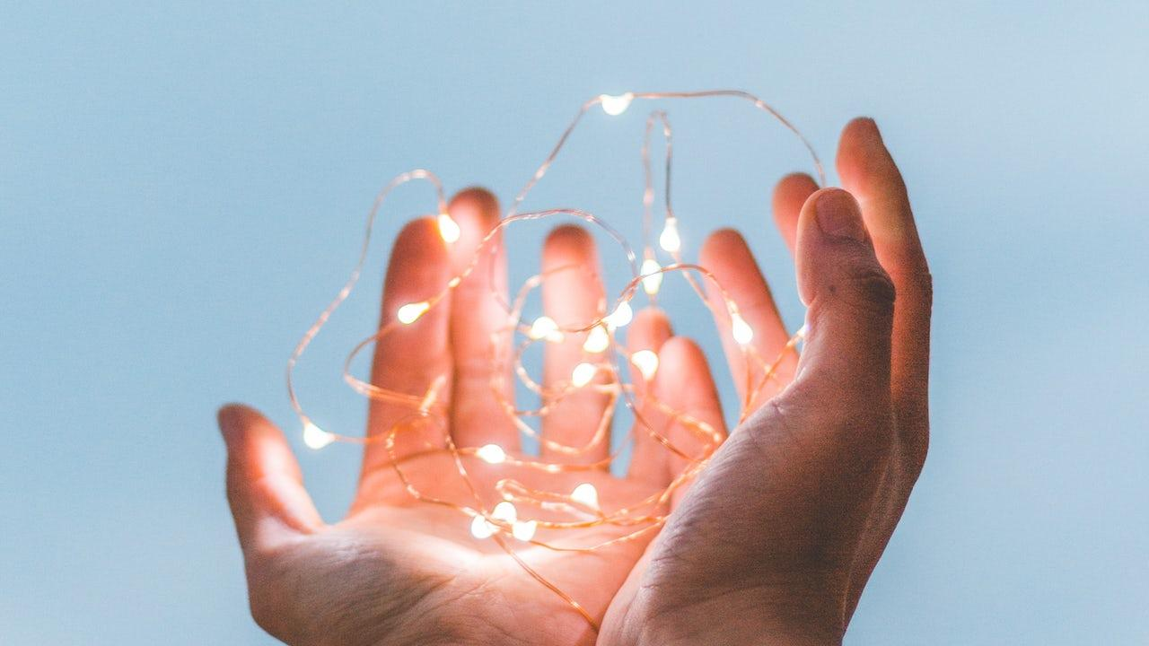
Presentation design
This presentation uses the following typographies:
Titles: Zilla Slab Light
Body copy: Zilla Slab Light
You can download the fonts on this page:
https://www.fontsquirrel.com/fonts/zilla-slab
You don’t need to keep this slide in your presentation. It’s only here to serve you as a design guide if you need to create new slides or download the fonts to edit the presentation in PowerPoint®

Slide 30
SlidesCarnival icons are editable shapes.
This means that you can:
Resize them without losing quality.
Change line color, width and style.
Isn’t that nice? :)
Examples:

Slide 31
😉
Now you can use any emoji as an icon!
And of course it resizes without losing quality and you can change the color.
How? Follow Google instructions https://twitter.com/googledocs/status/730087240156643328
✋👆👉👍👤👦👧👨👩👪💃🏃💑❤😂😉😋😒😭👶😸🐟🍒🍔💣📌📖🔨🎃🎈🎨🏈🏰🌏🔌🔑 and many more...

